Slide 1
Erika Hernandez
NET 4740
in
Class Presentation

Slide 2
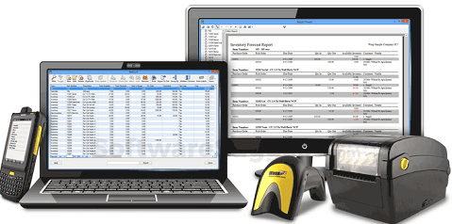


Basic 1- Inventory and Control Hardware Assets
Asset Owner
Asset Physical Location
Assigned assets department
Authorized devices
Controlling
Replacement
Notes:
#1. Inventory of Authorized and Unauthorized Devices.
Organizations must actively manage all the hardware devices on the network, so that only authorized devices are given access and unauthorized devices can be quickly identified and disconnected before they inflict any harm.
Why is this critical? Attackers are continuously scanning the address space of organizations, waiting for new and unprotected systems to be attached to the network. This control is especially critical for organizations that allow BYOD, since hackers are specifically looking for devices that come and go off of the enterprise’s network.

Slide 3
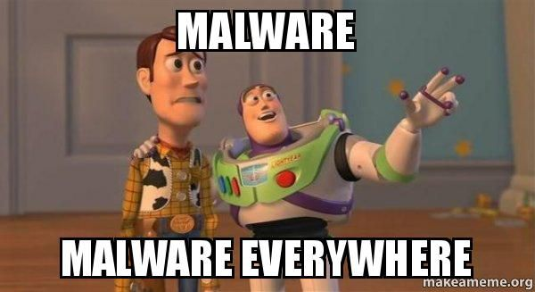
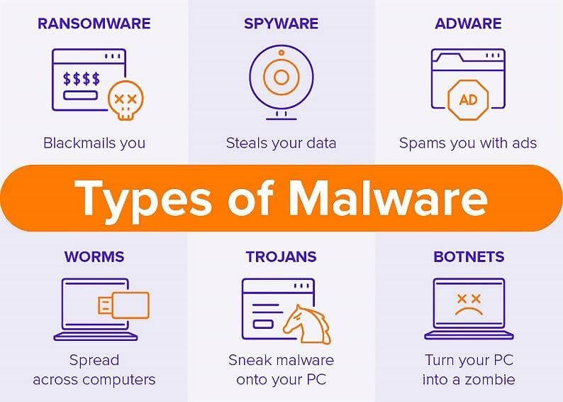
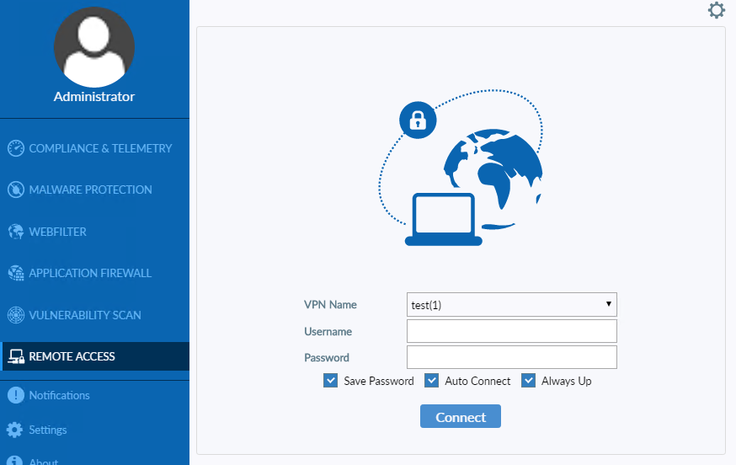
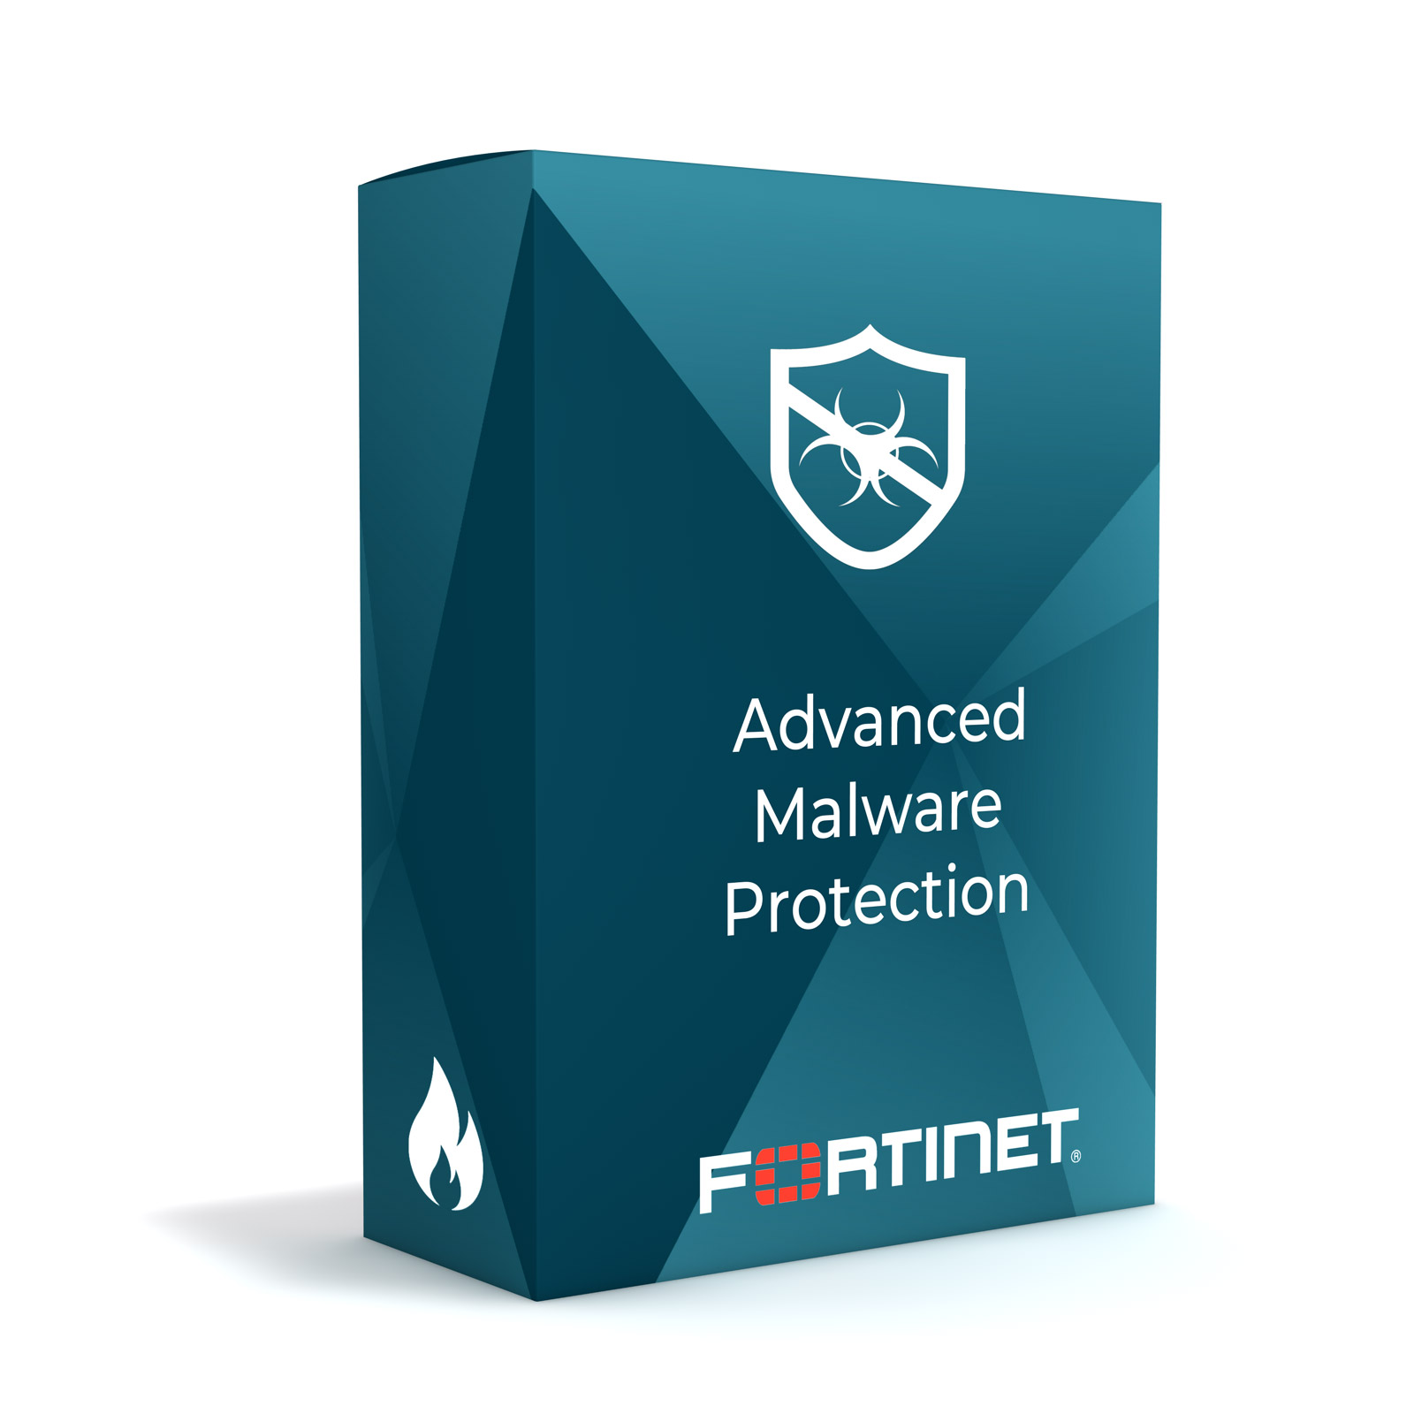
Foundational 8 - Malware Defense
Constantly Evolving
Can cost an organization money
Can enter at any points
Notes:
#8. Malware Defenses.
Organizations need to make sure they can control the installation and execution of malicious code at multiple points in the enterprise. This control recommends using automated tools to continuously monitor workstations, servers and mobile devices with anti-virus, anti-spyware, personal firewalls and host-based IPS functionality.
Why is this critical? Modern malware can be fast-moving and fast-changing, and it can enter through any number of points. Therefore, malware defenses must be able to operate in this dynamic environment through large-scale automation, updating and integration with processes like incident response.

Slide 4
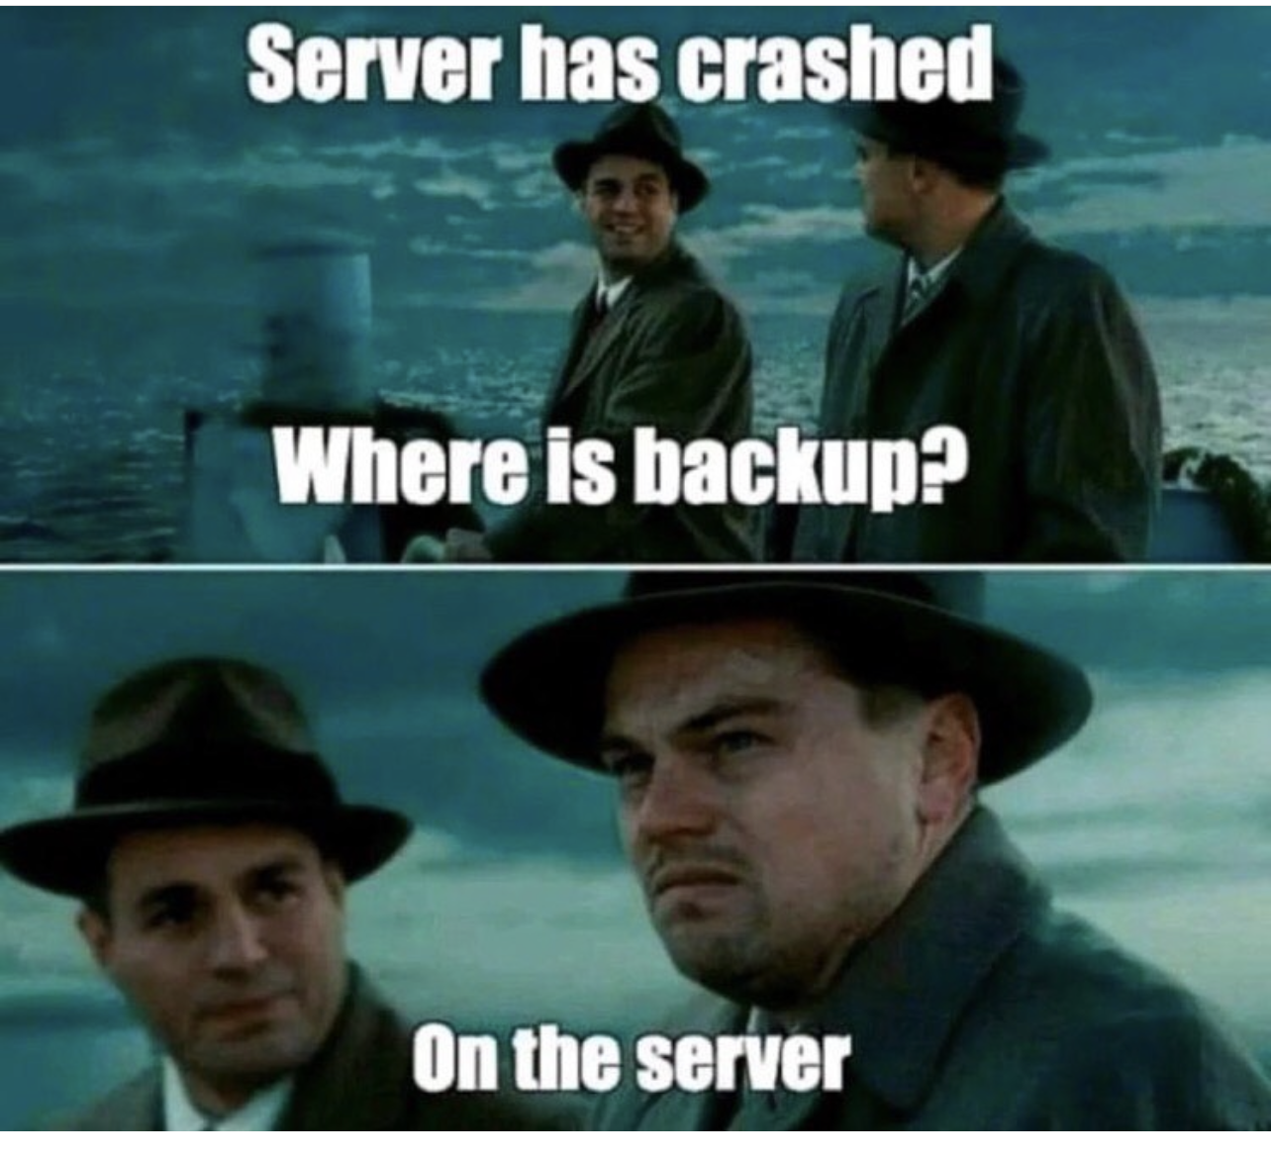
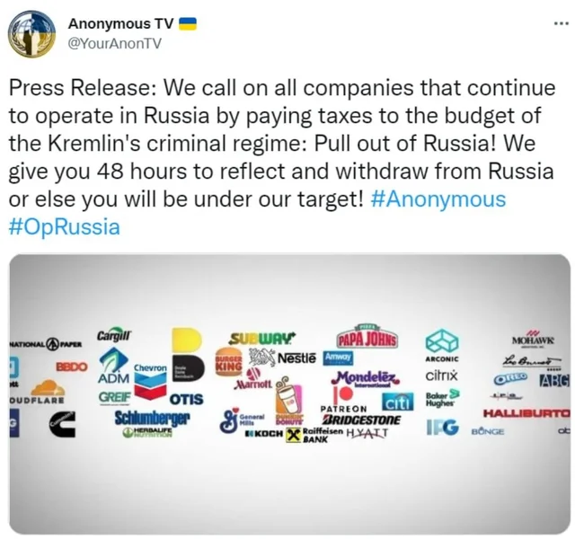

Foundational 13 - Data Protection
Data breach in 2021 in US $4.24 Million
Data protection is important
Mitigate the risk of data
Protect sensitive information
Notes:
#13. Data Protection.
Organizations must use appropriate processes and tools to mitigate the risk of data exfiltration and ensure the integrity of sensitive information. Data protection is best achieved through the combination of encryption, integrity protection and data loss prevention techniques.
Why is this critical? While many data leaks are deliberate theft, other instances of data loss or damage are the result of poor security practices or human errors. To minimize these risks, organizations need to implement solutions that can help detect data exfiltration and mitigate the effects of data compromise.

Slide 5
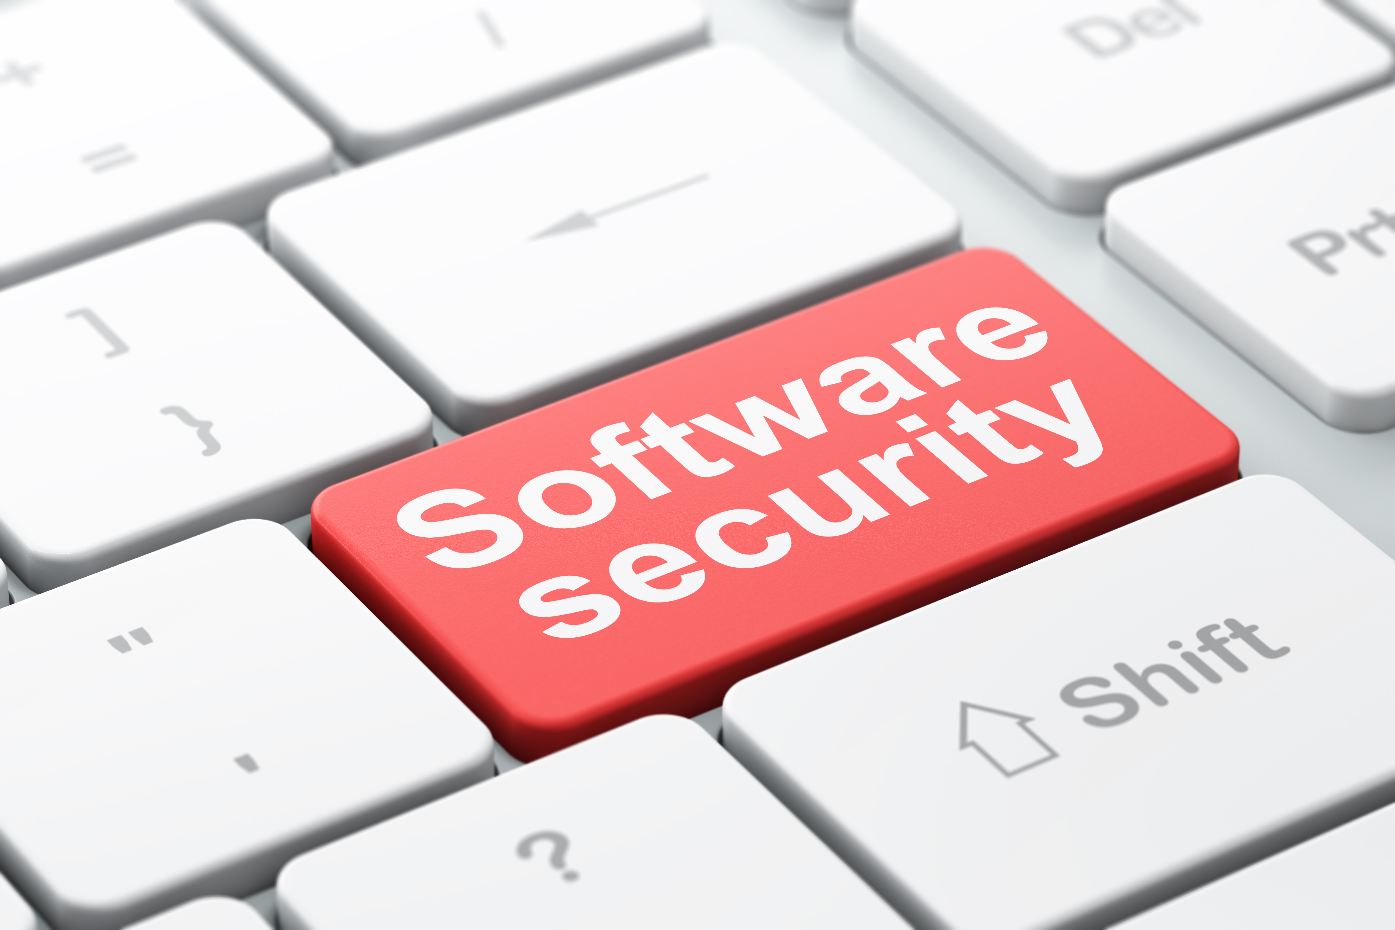
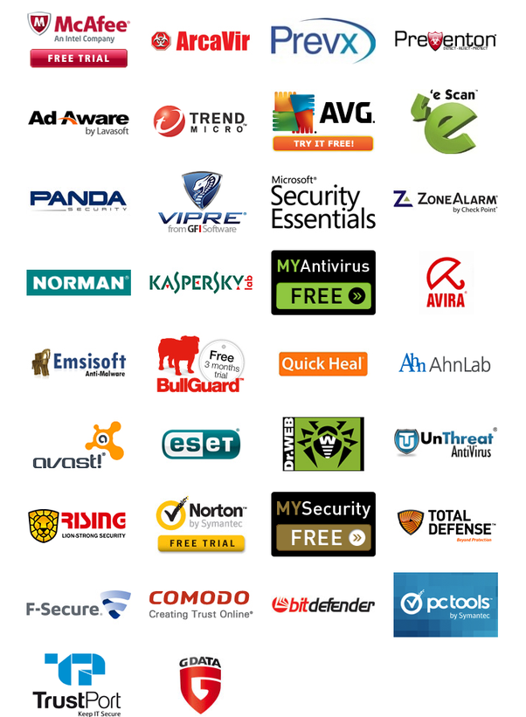

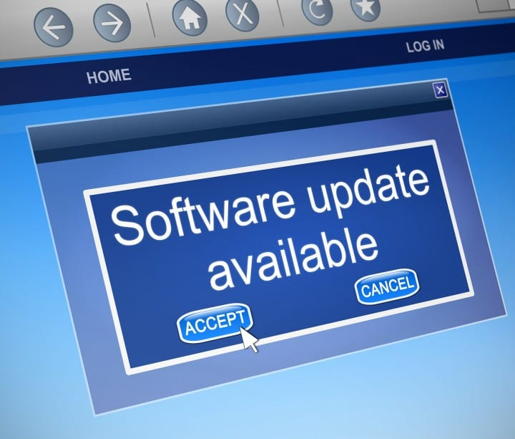
Organizational 18 – Application Software Security
Update software
Patching vulnerabilities
Mitigate attacks in the organization
Notes:
#18. Application Software Security.
Organizations must manage the security lifecycle of all software they use in order to detect and correct security weaknesses. In particular, they must regularly check that they use only the most current versions of each application and that all the relevant patches are installed promptly.
Why is this critical? Attackers often take advantage of vulnerabilities in web-based applications and other software. They can inject specific exploits, including buffer overflows, SQL injection attacks, cross-site scripting and click-jacking of code, to gain control over vulnerable machines.

Slide 6
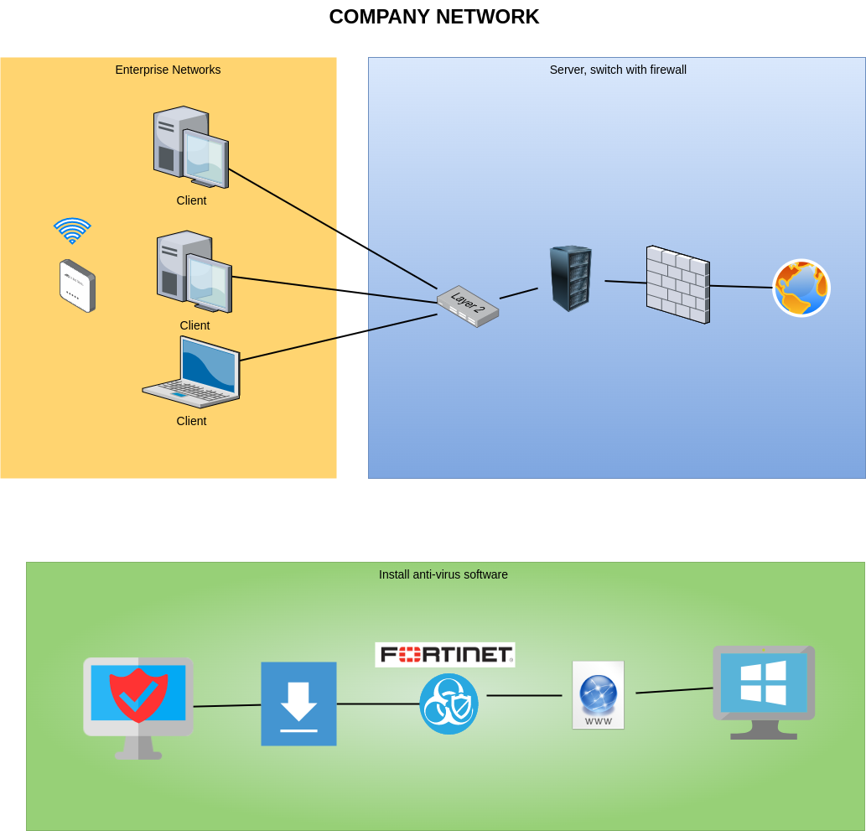
Implementation- Download Malware Software
Open File Manager
Double click on application installer .exe file
Download
Open FortiClient
Enter credentials
Protected computer

Slide 7
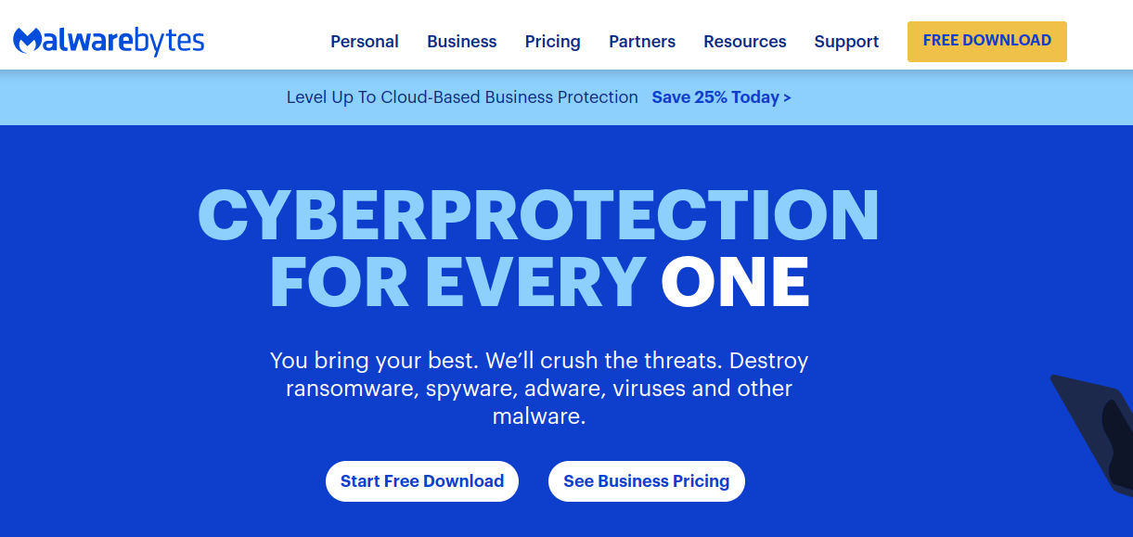
Implementation- Download Malware Software
https://www.malwarebytes.com/
Click on Download
Open File Manager
Double click on application installer .exe file
Download
Open Malwarebytes
Click on scan
Protected computer

Slide 8

Erika Hernandez
Thank you!

